Slide 1
Micro Credit Defaulter Project
Submitted by: Harshita Panchamia
Batch : Internship 25

Slide 2
Problem Statement
A Microfinance Institution (MFI) is an organization that offers financial services to low income populations. MFS becomes very useful when targeting especially the unbanked poor families living in remote areas with not much sources of income. The Microfinance services (MFS) provided by MFI are Group Loans, Agricultural Loans, Individual Business Loans and so on.
We are working with one such client that is in Telecom Industry. They are a fixed wireless telecommunications network provider. They have launched various products and have developed its business and organization based on the budget operator model, offering better products at Lower Prices to all value conscious customers through a strategy of disruptive innovation that focuses on the subscriber.
They are collaborating with an MFI to provide micro-credit on mobile balances to be paid back in 5 days.
The Consumer is believed to be defaulter if he deviates from the path of paying back the loaned amount within the time duration of 5 days.
For the loan amount of 5 (in Indonesian Rupiah), payback amount should be 6 (in Indonesian Rupiah), while, for the loan amount of 10 (in Indonesian Rupiah), the payback amount should be 12 (in Indonesian Rupiah).

Slide 3
Problem Excericse
Build a model which can be used to predict in terms of a probability for each loan transaction, whether the customer will be paying back the loaned amount within 5 days of insurance of loan.
In this case, Label ‘1’ indicates that the loan has been payed i.e. Non- defaulter, while, Label ‘0’ indicates that the loan has not been payed i.e. defaulter

Slide 4
Technical Requirements
There are no null values in the dataset.
There may be some customers with no loan history.
The dataset is imbalanced. Label ‘1’ has approximately 87.5% records, while, label ‘0’ has approximately 12.5% records.
For some features, there may be values which might not be realistic. You may have to observe them and treat them with a suitable explanation.
You might come across outliers in some features which you need to handle as per your understanding. Keep in mind that data is expensive and we cannot lose more than 7-8% of the data.

Slide 5
Data Preprocessing
On data exploration, I found that the dataset was imbalanced for the target feature(87.5% for Non-defaulters and 12.5% for Defaulters). Also, I found that the data had some very unrealitic values such as 999860 days which is not possible.
Also, there were negative values for variables which must not have one (example:frequency,amount of recharge etc). All these unrealistic values were dropped which caused a data loss of 8% only.
On visualizing data, there were two important insights I gathered. a. Imbalance of data b. Distribution was not normal

Slide 6
Data Preprocessing
Since the data was not normal, I normalized all the features except the target variable which was dichotomous(Values '1' and '0').
Since the data was expensive, I did not want to lose out on data by under sampling the majority class. Instead, I decided to oversample the minority class using SMOTE
Since it was a supervised classification problem, I built 4 models to evaluate performance of each of them: a. Logistic Regression, b. Kneighbor’s Classifier, c. Decision Tree Classifier, d. Random Forest Classifier.

Slide 7
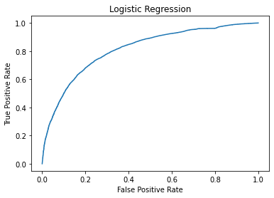
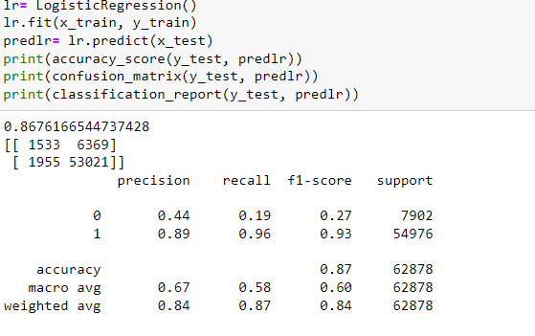
1. Logistic Regression

Slide 8
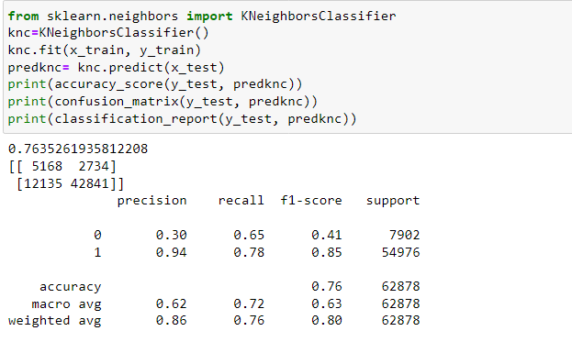
2. K Neighbors Classifier

Slide 9
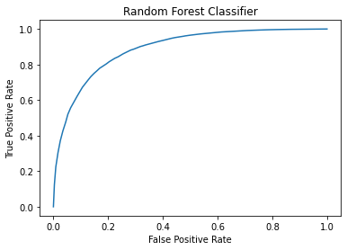
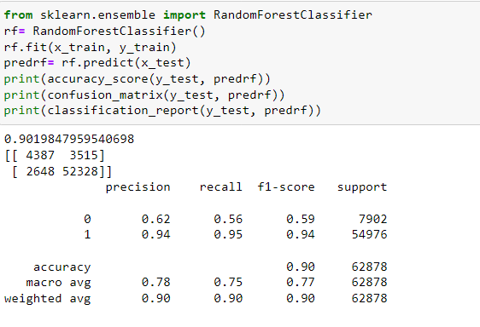
3. Random Forest Classifier

Slide 10
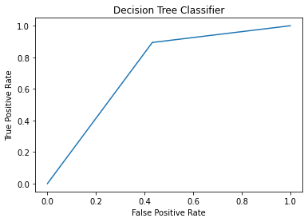
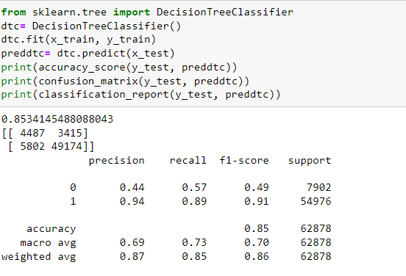
4. Decision Tree Classifier

Slide 11
Conclusion
Hence, we got the best accuracy score from Random Forest Classifier.

